Slide 1

AID ESCALATING INTERNET COVERAGE
Group Name- Zero Accuracy
Prasad Magdum (MT2022078)
Prateek Chhimwal (MT2022080)

Slide 2
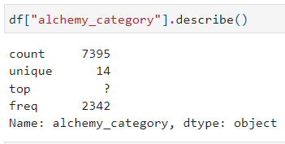
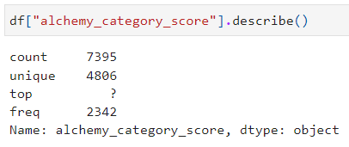
Data Preprocessing
Observed statistical data- frame_based column is removed since all values are zero.
Checked for NULL values- There are no NULL values in the dataset.
Checked for missing values. (Present)
Handling missing values for the following column-
alchemy_category- Replaced "?" with mode (recreation).

Slide 3
Data Preprocessing(Cont.)
alchemy_category_score- Replaced "?" With mean value.
is_news- Dropped the column as there are only missing value and "1" in the attribute.
news_front_page- Replaced with mode(0).
5. Checked for duplicate values- There are no duplicate values in the dataset.
6. Coverted object datatype to numeric.
7. Converted categorical data (alchemy_category) into numerical data using one hot encoding.

Slide 4
Data Preprocessing(Cont.)
8. Used regular expression to remove special characters, Numbers from the page description column.
9. Used TF-IDF word embedding technique for page_description column to convert from text to numerical data. TF-IDF is a popular approach used to weigh terms for NLP tasks.
10. NLP Preprocessing
Tokenization
Stop word removal
Lemmatization
TF-IDF vectorization

Slide 5
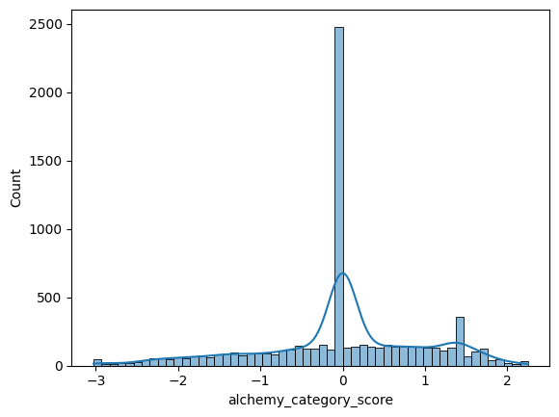
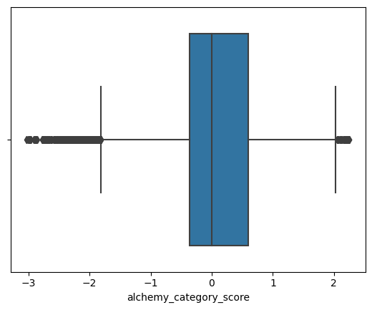
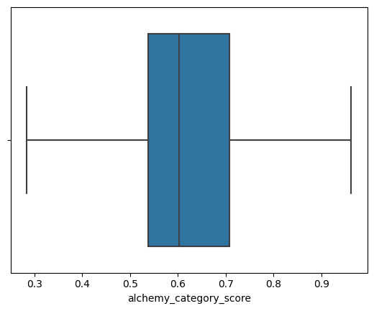
Exploratory Data Analysis
1. Standardization
We have standardized all the columns in the dataset.
2. Removed the outlier from the data.
If the data point lies beyond upper whisker and lower whisker we brought them between lower whisker and upper whisker.
3. Checked for skewness in the few columns.
4. Draw Correlation Matrix for further analysis.

Slide 6
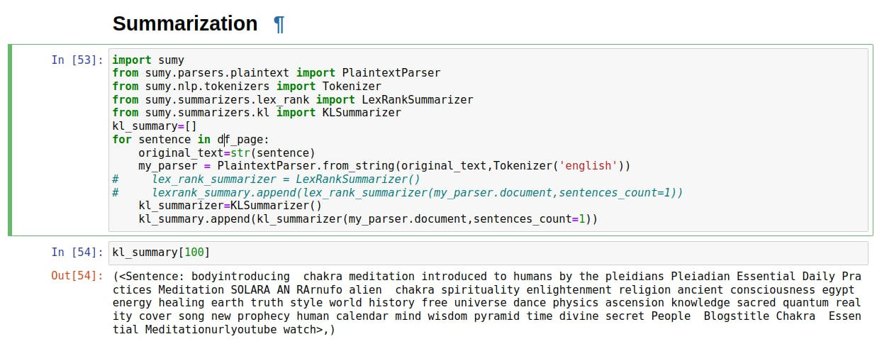
Learning Algorithm
We used Term Frequency-Inverse Document Frequency along with Logistic regression to do the binary classification.Input to the algorithm was page_description and alchemy_category_score.
Output is binary 0/1. The target vector takes two values 0/1 not ad-worthy and ad-worthy.
Summarization (Algorithm)

